Slide 1

Welcome to join Harbor Community Conference Call
APAC: 21:00-21:30 (Beijing Time)
/ 06:00-06:30 AM (PDT)
US: 13:00-13:30 (PDT)
2019/06/05 Wednesday
https://zoom.us/j/734959521
Twitter
Maillist
Slack (slack.cncf.io)
@project_harbor
harbor-users@googlegroups.com
#harbor
#harbor-dev
harbor-dev@googlegroups.com

Slide 2

Release V1.8 – Prepare script refactor
Meeting Host
Qian Deng (github:ninjadq)
Harbor maintainer

Slide 3
Agenda
Harbor V1.9 plan
Community Updates
Upcoming community events
Free talk: any community/project topics discussions

Slide 4
V1.9 plan
V1.9 plan discussions : https://github.com/orgs/goharbor/projects/1

Slide 5
Harbor in KubeCon EU
KubeCon EU @ Barcelona May20th – May 23th
Harbor 1.8 released!
Harbor community reception at 14:30 May 20th
Harbor intro by Henry Zhang & Steven Ren at 14:50 May 21st
Harbor deep dive by Steven Z & Daniel Jiang at 14:50 May 22nd

Slide 6
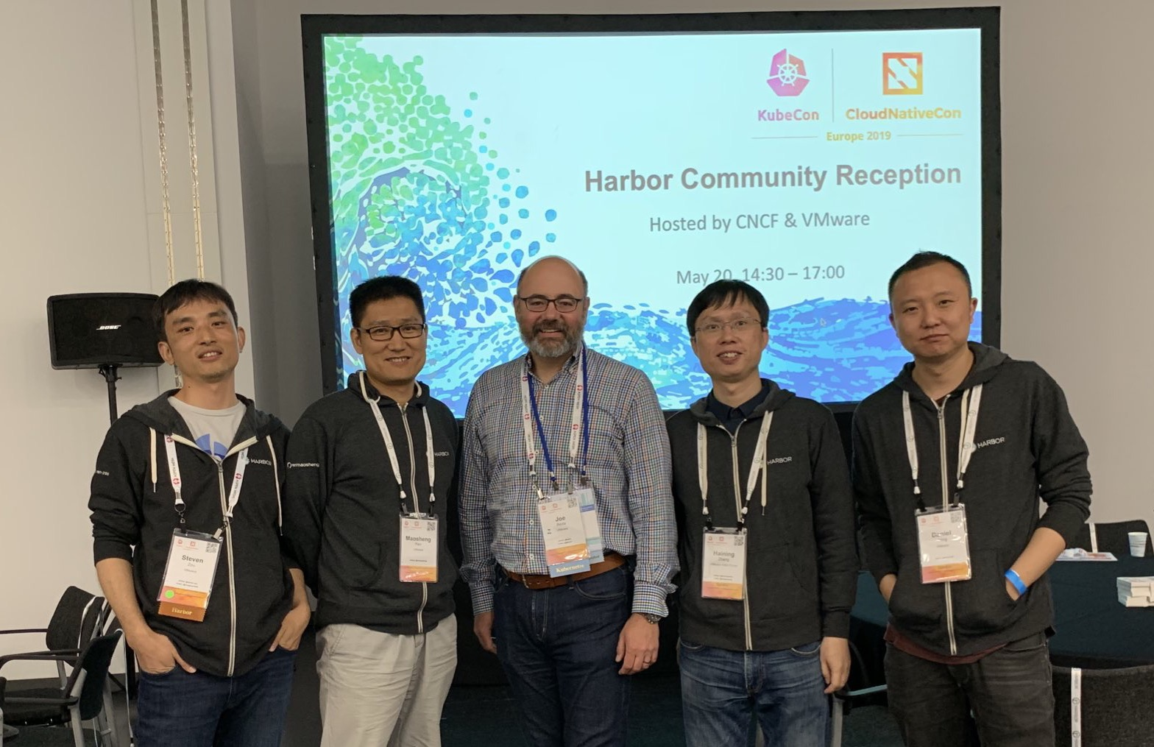
Harbor Community Reception
Met many Harbor users
Discussed roadmap and use cases
Kubernetes co-founder Joe Beda kicked off the reception

Slide 7
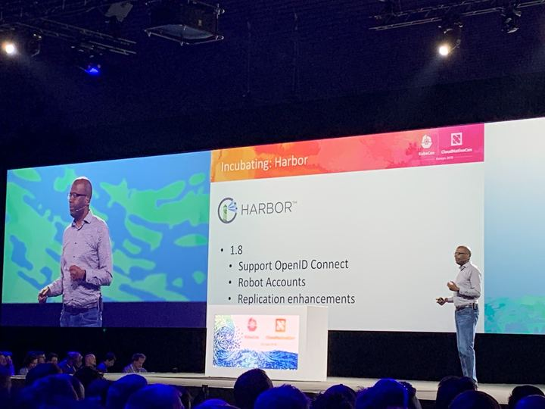
Harbor v1.8 released
OIDC (Open ID Connect)
Robot account for system integration (e.g. CI/CD)
Replication advancements
Heterogenous registries: Docker Hub, Docker Distribution, Huawei Registry
Pull / push mode
Health check API
Swagger UI for exploring and triggering Harbor API
Cron-based scheduling tasks: scan, garbage collection and replication
Bug fixes
Blog: https://www.cncf.io/blog/2019/05/21/going-big-harbor-1-8-takes-security-and-replication-to-new-heights/
Keynote speech on Day 1

Slide 8
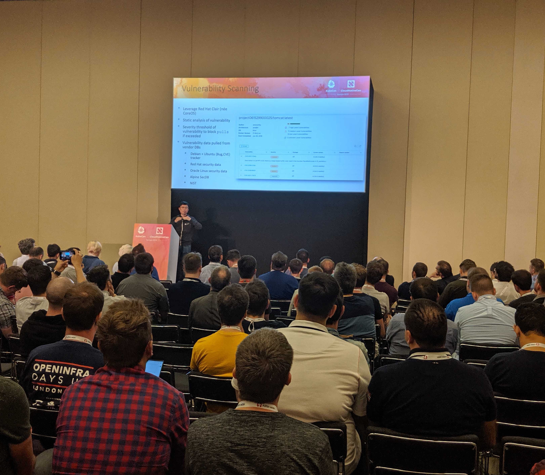
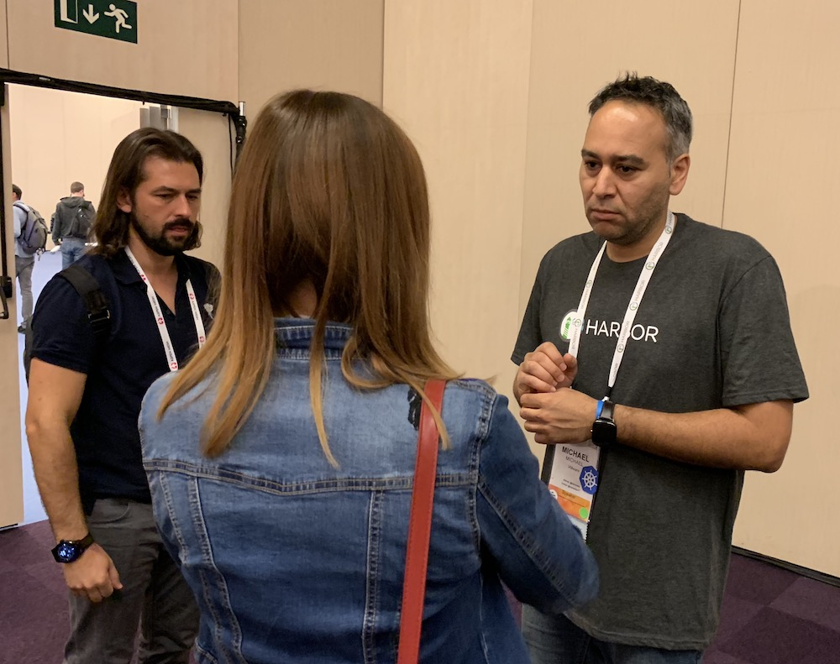
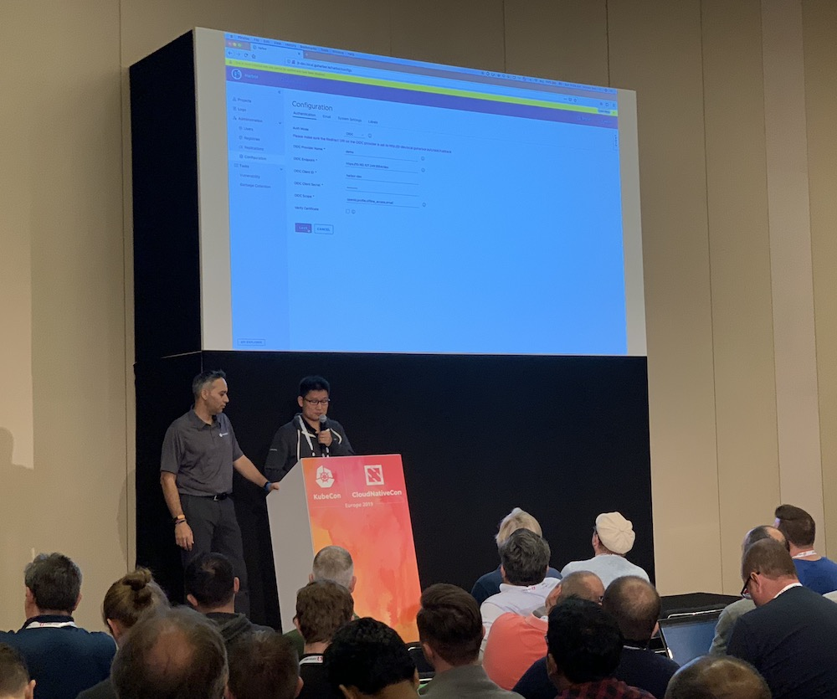
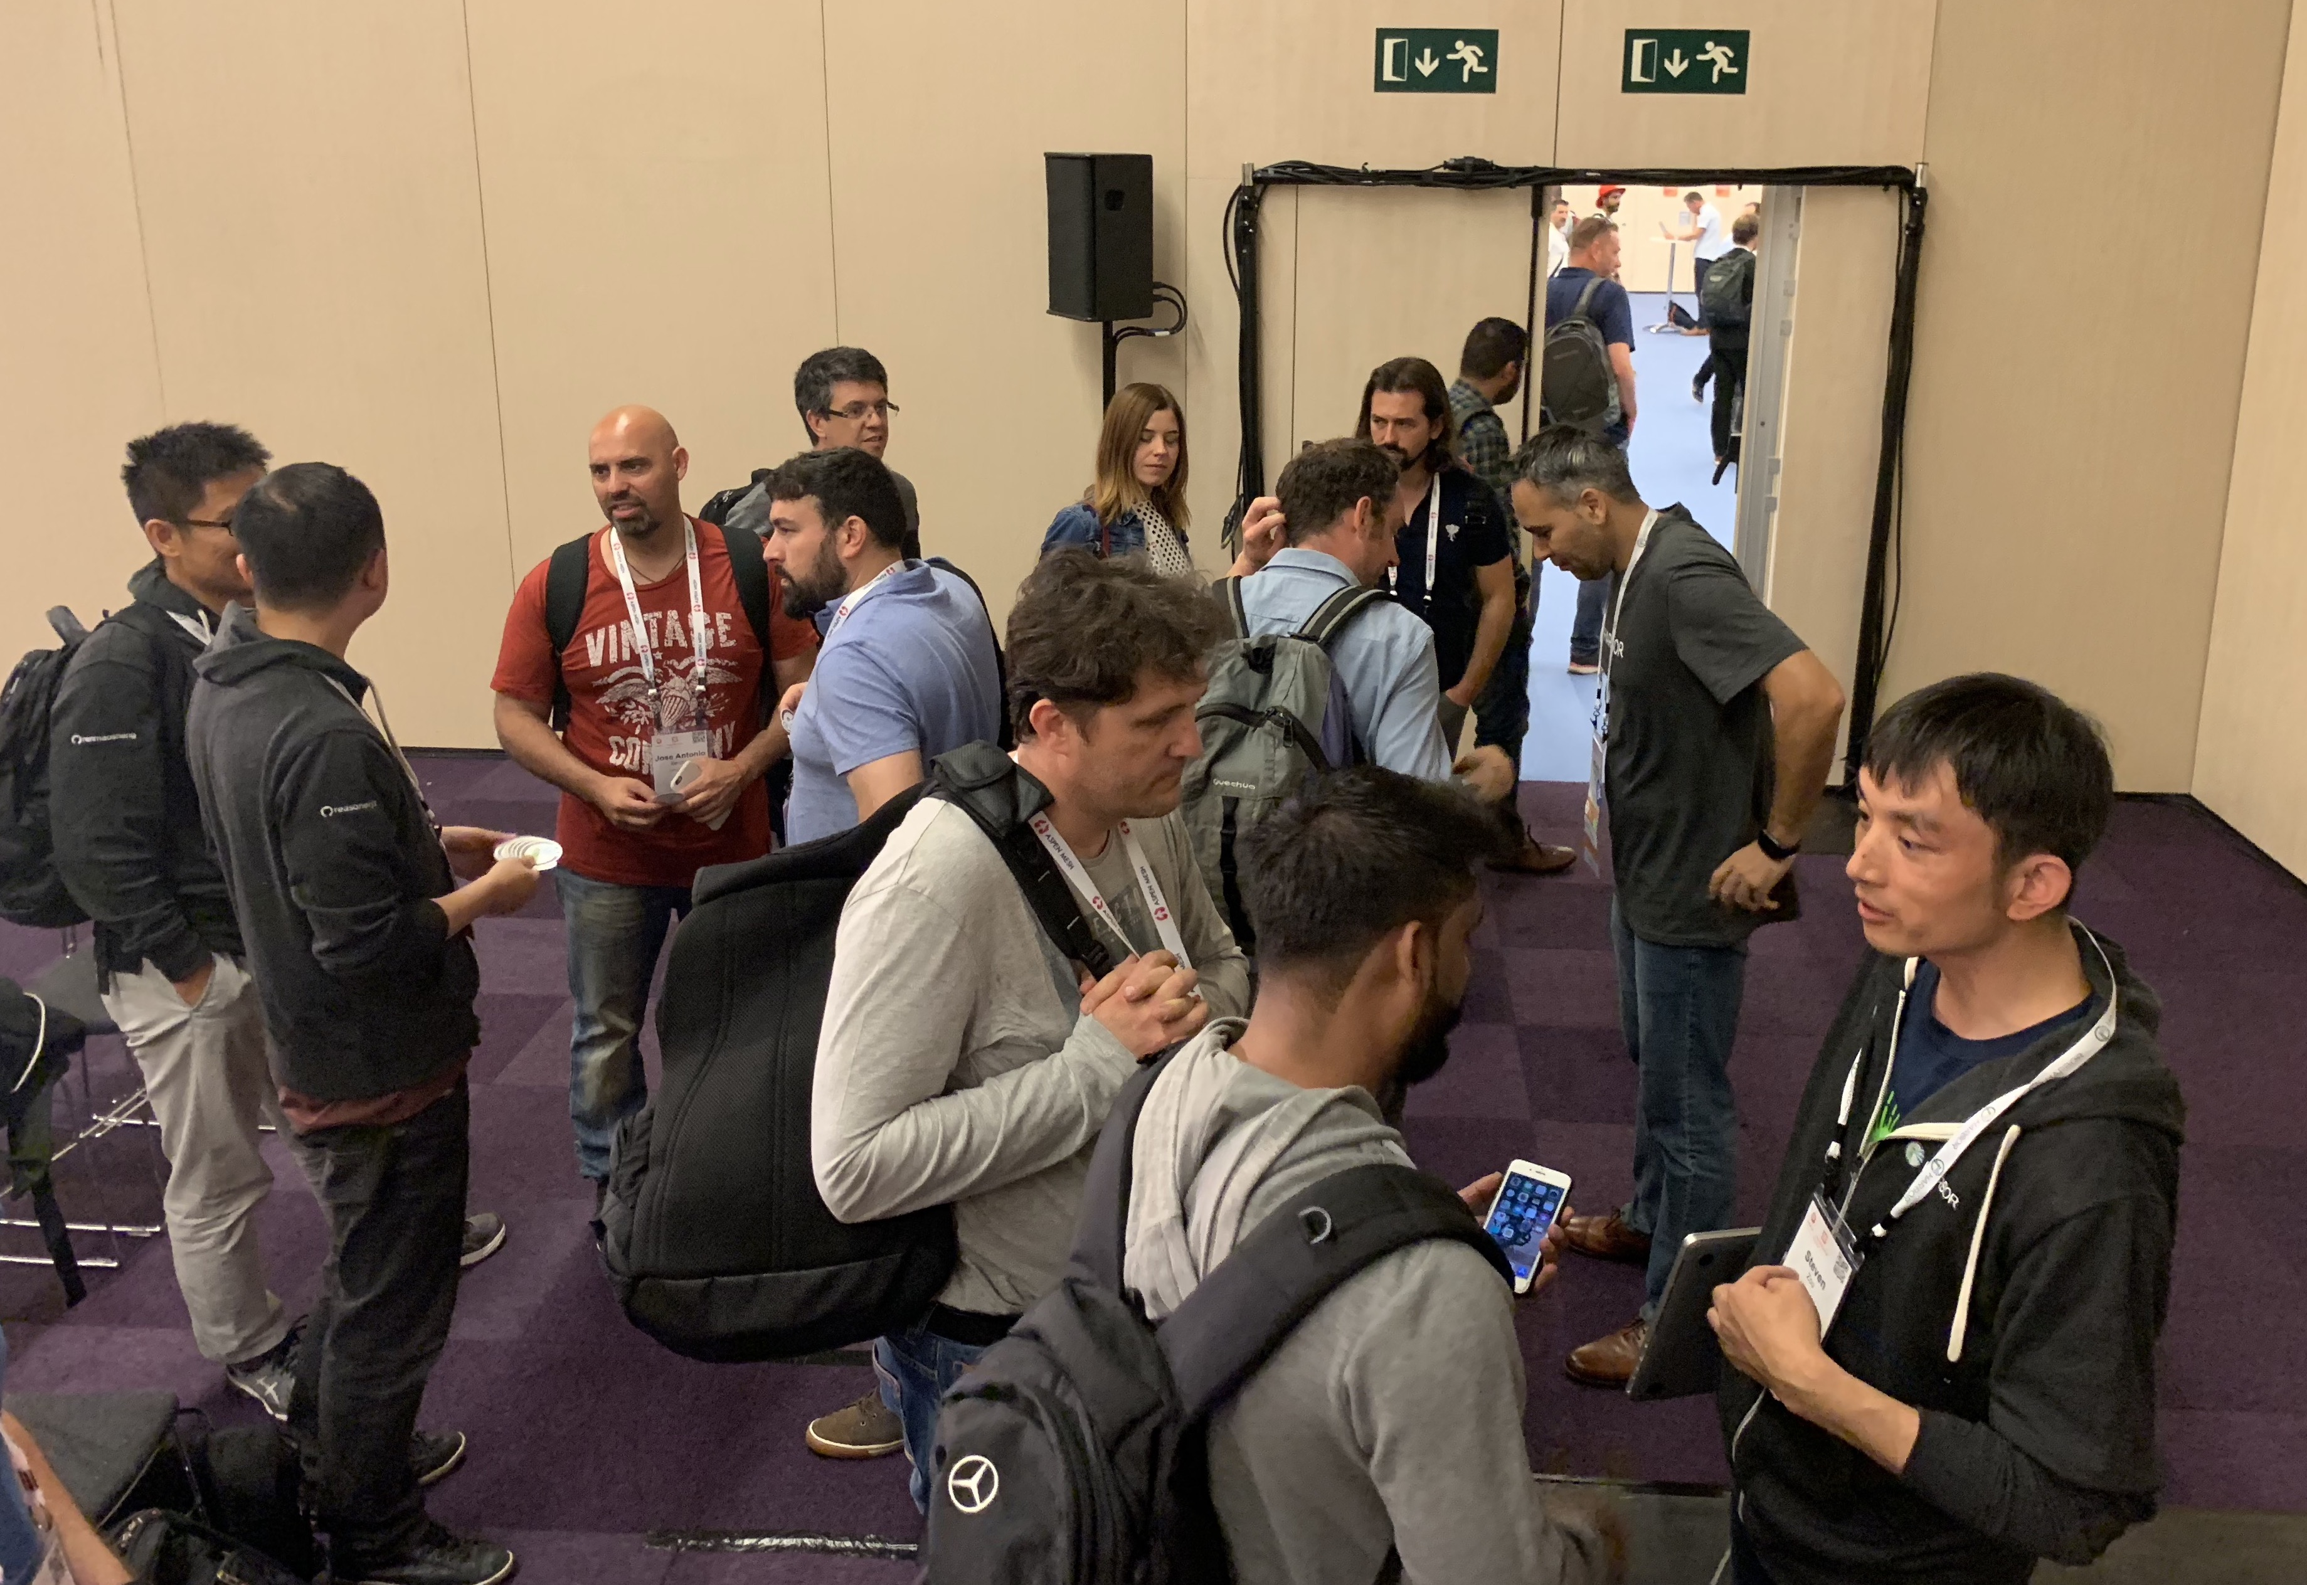
Harbor Intro and Deep-Dive Sessions
Huge interest on Project Harbor
Full house for both sessions
Users from different countries
Intro session video:
https://youtu.be/REgvBPH369M
Deep-Dive session video:
https://youtu.be/cGV9P3UqZB8

Slide 9
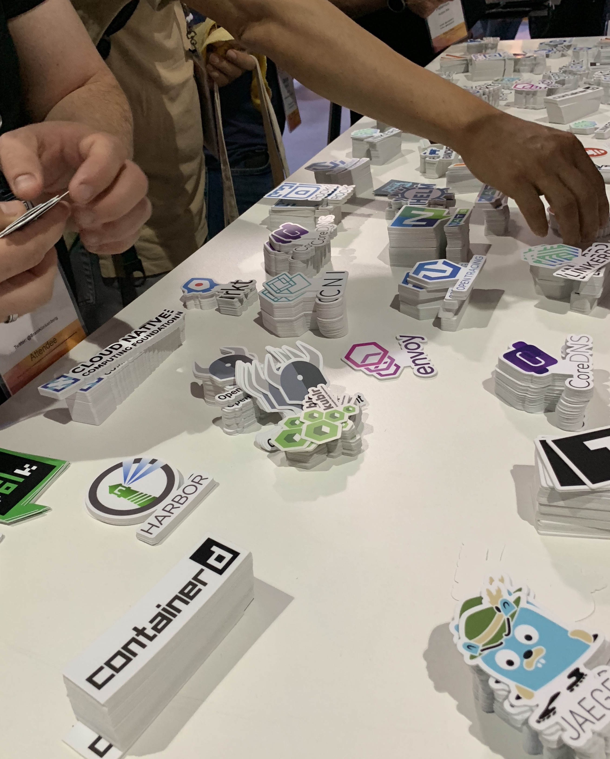
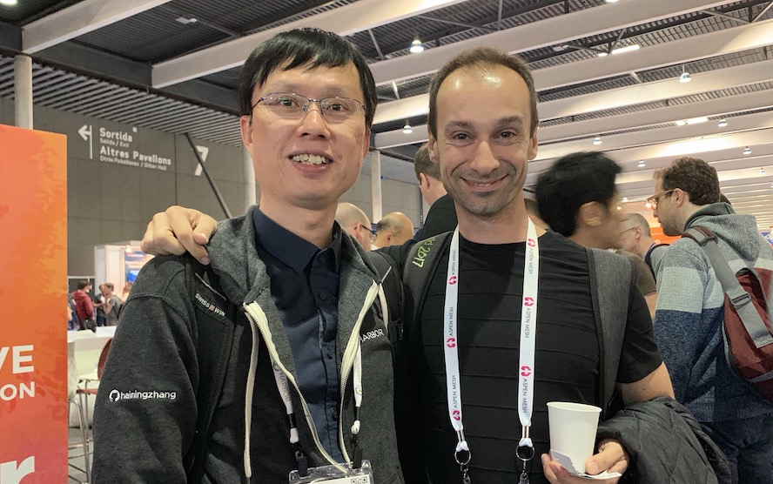
More about Harbor in KubeCon EU
Met users in CNCF Answer Bar
Collaboration with other projects
Harbor stickers were out of stock at the venue
Henry Zhang and a Harbor user from Turkey
Harbor stickers ran out fast!

Slide 10
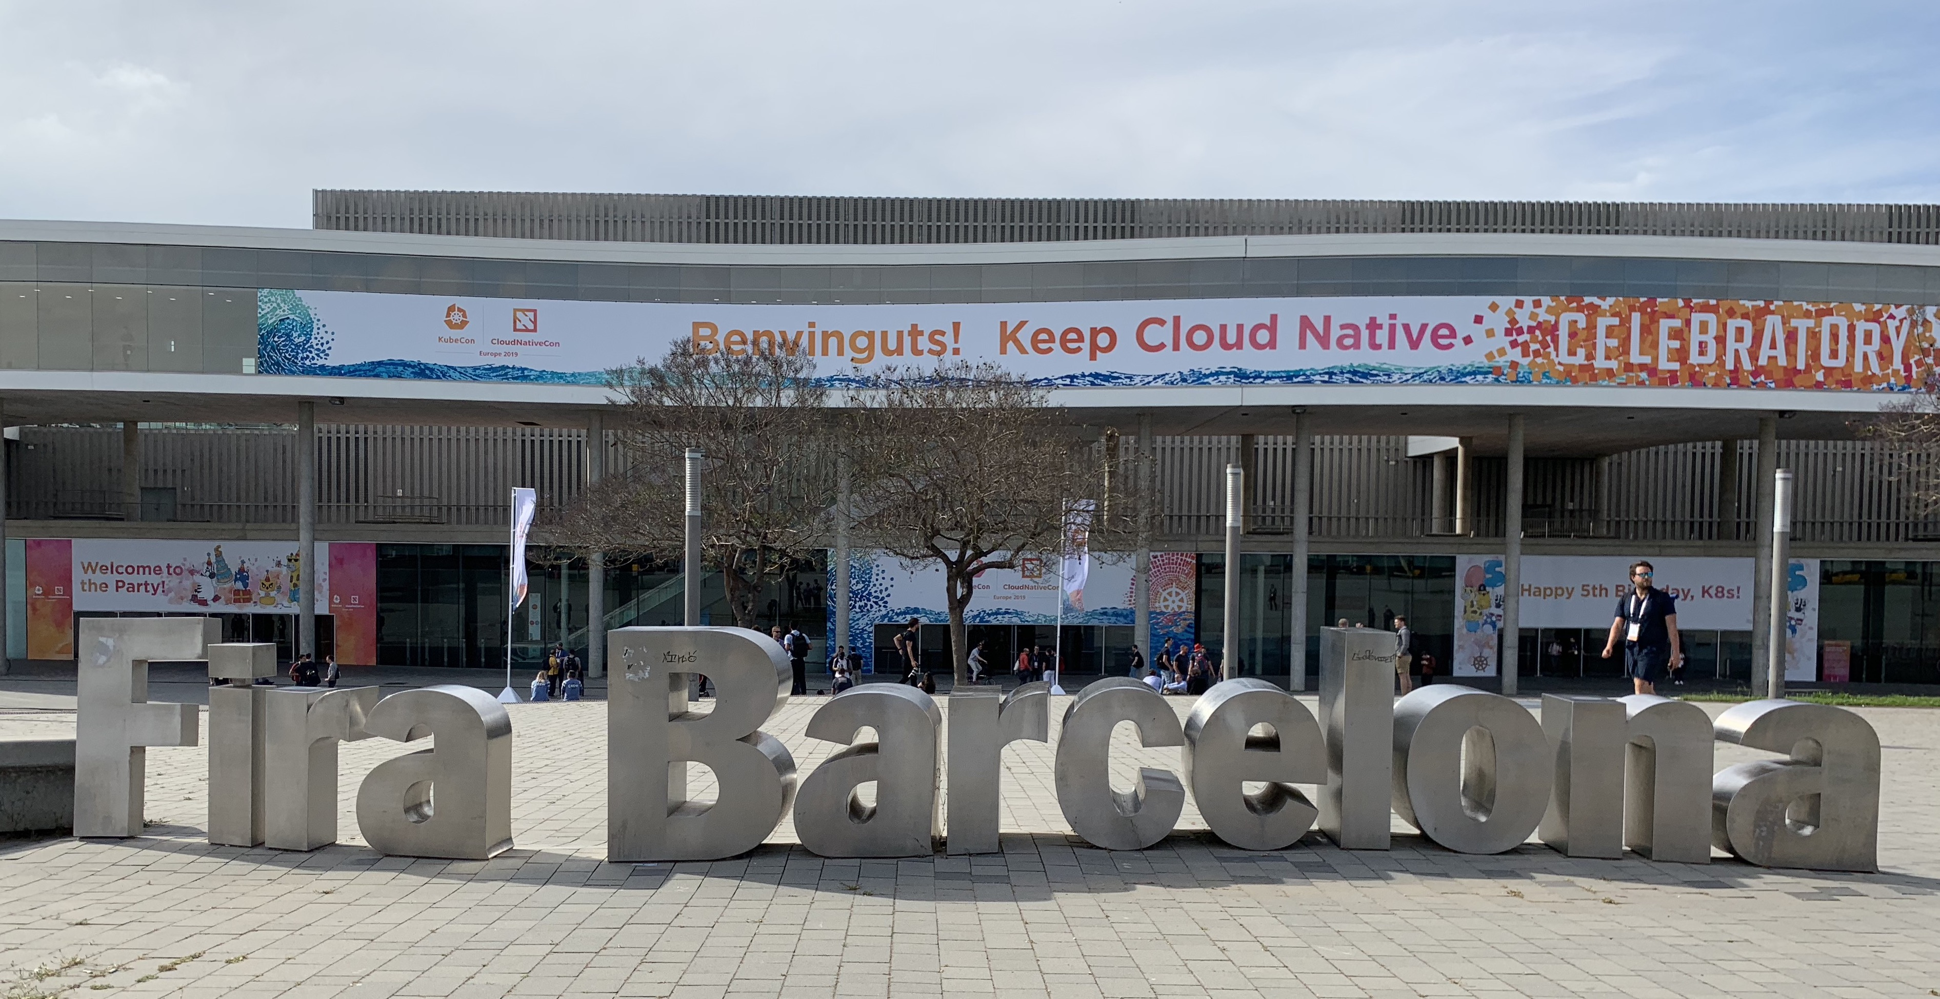
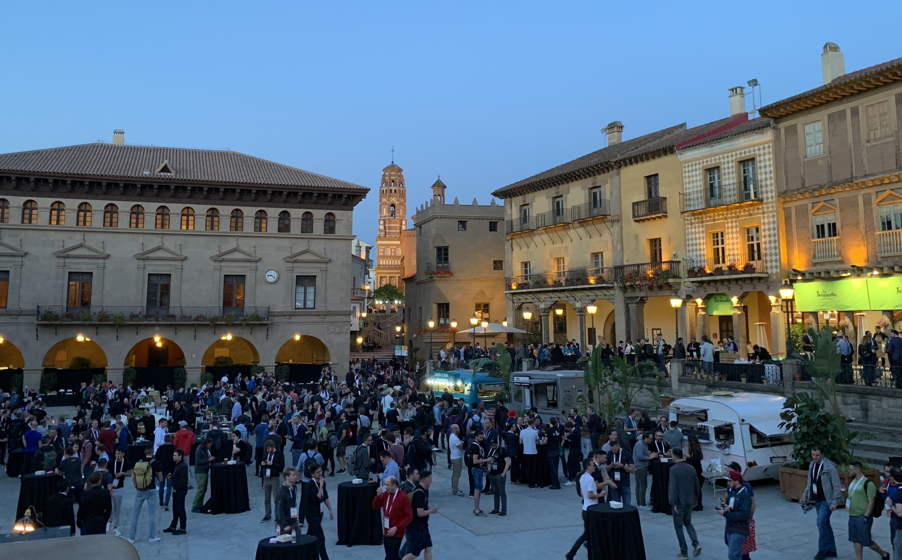
Some photos of KubeCon EU

Slide 11
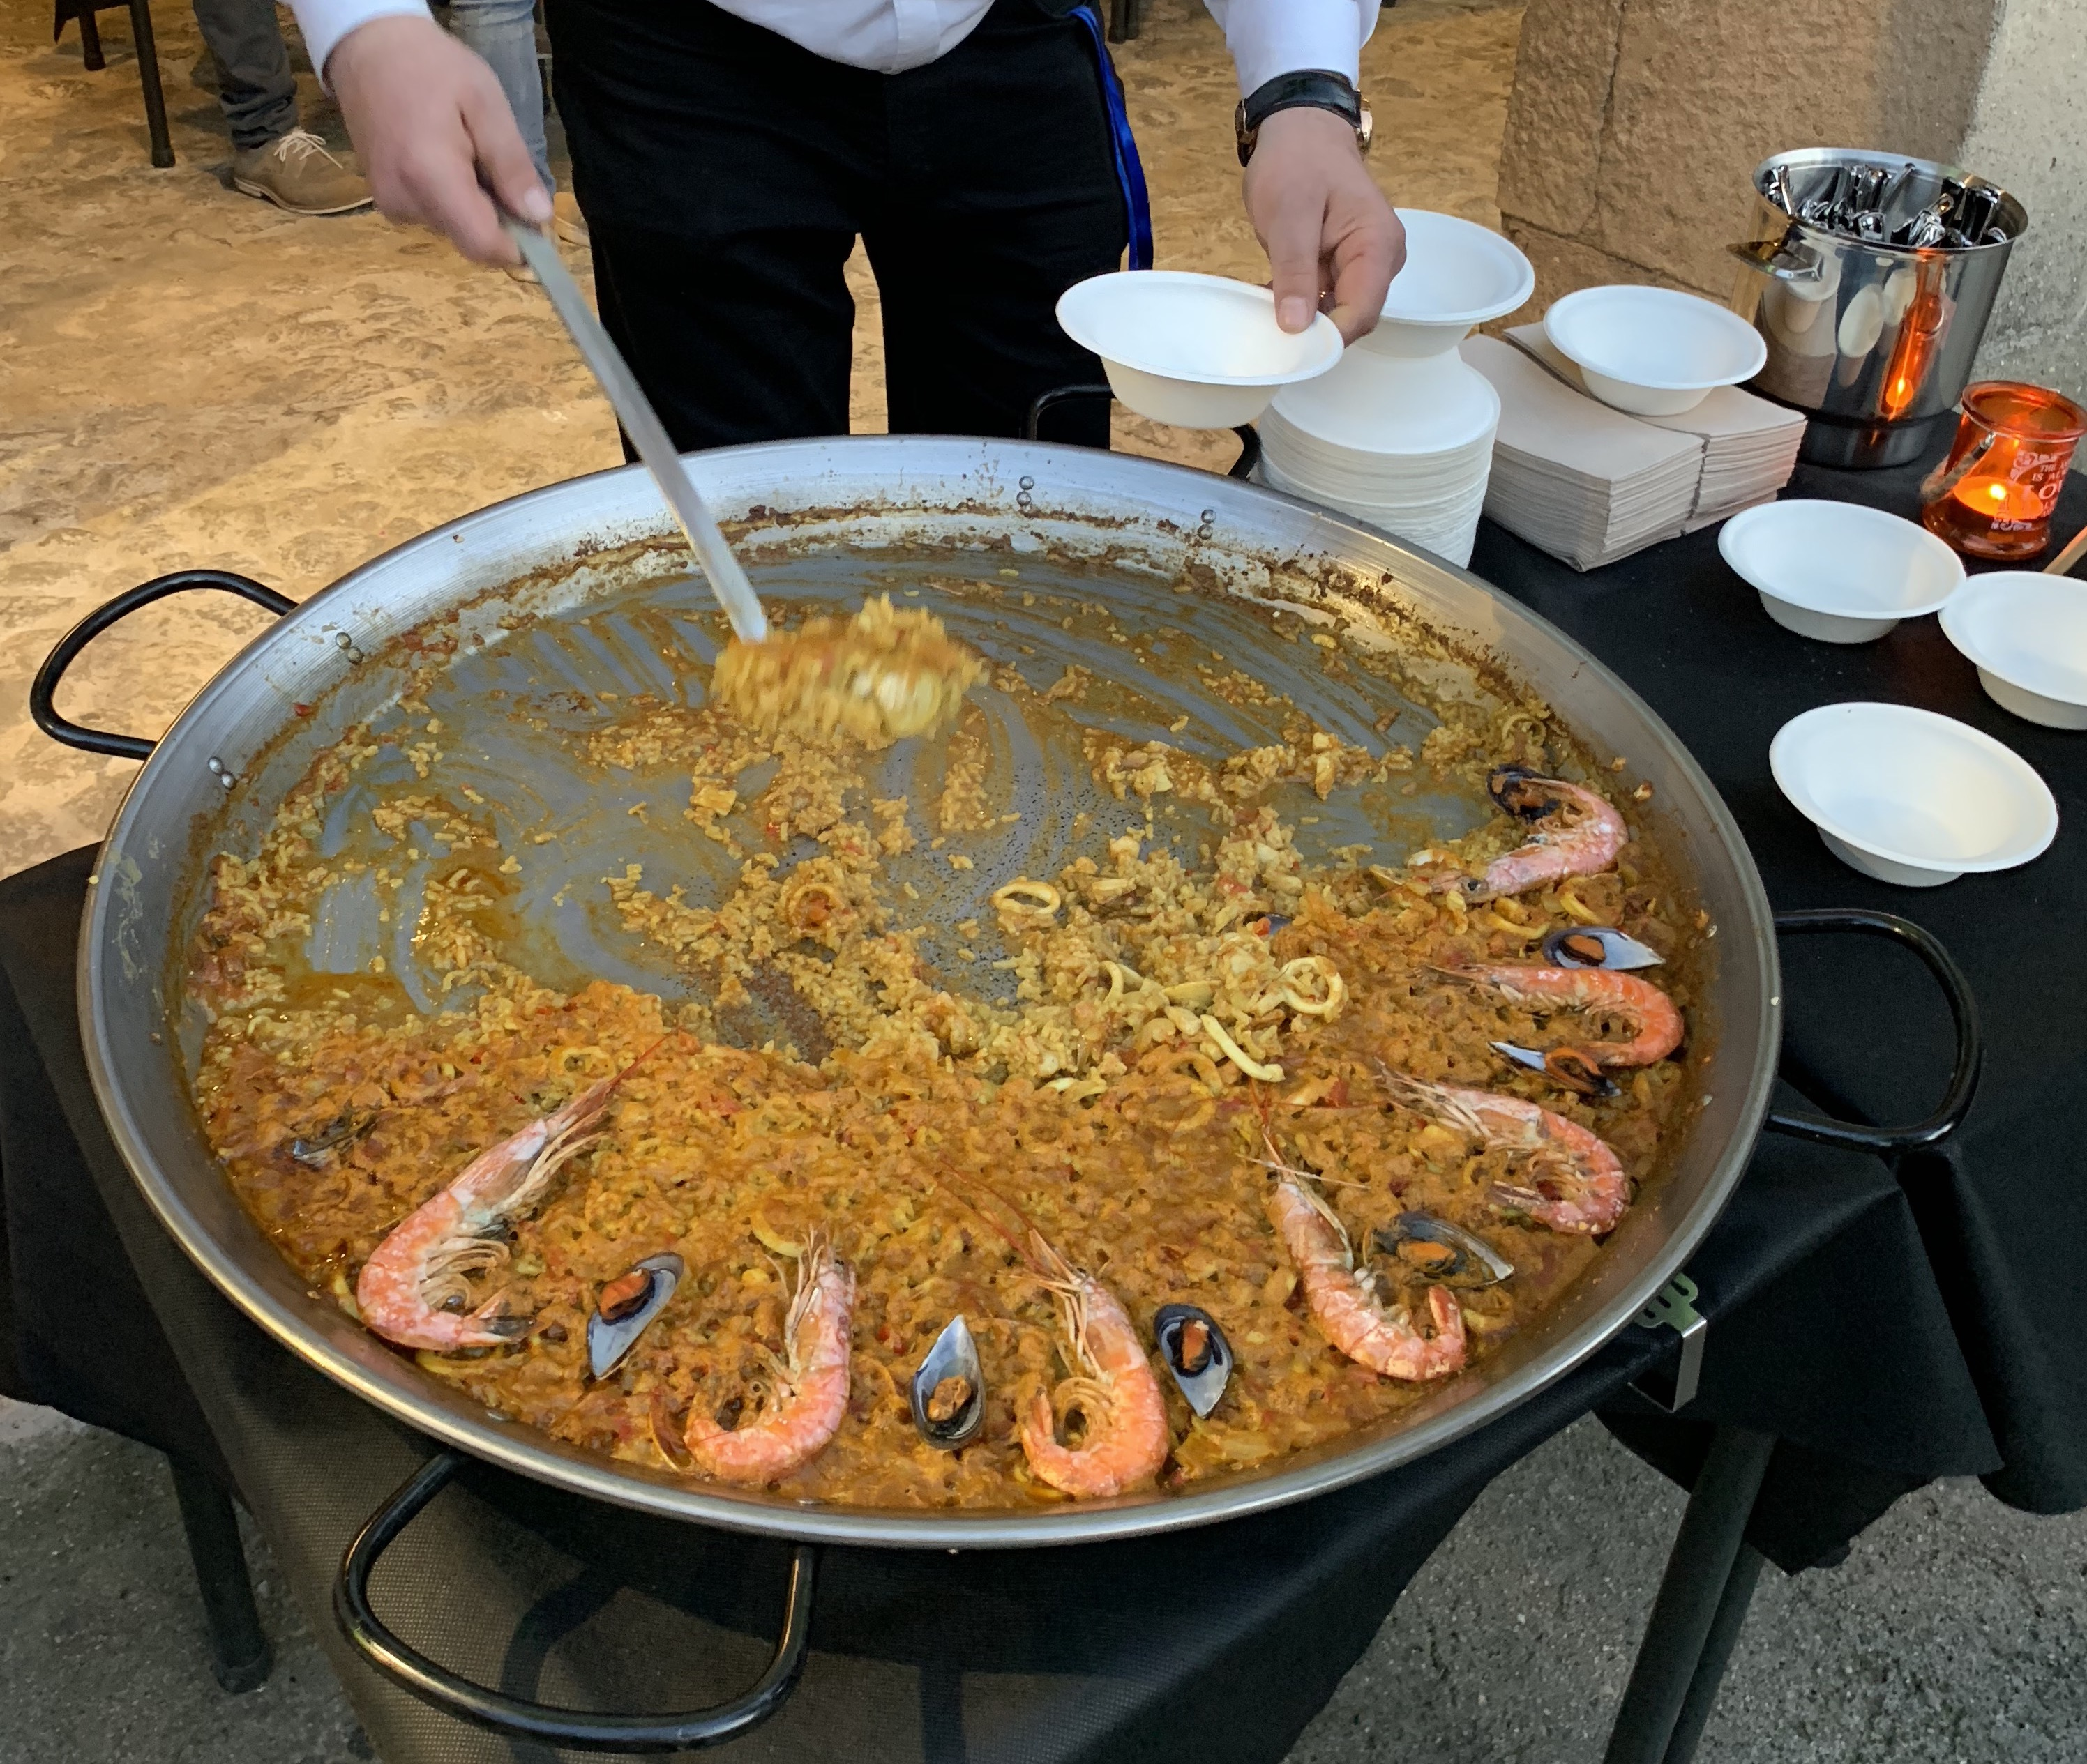
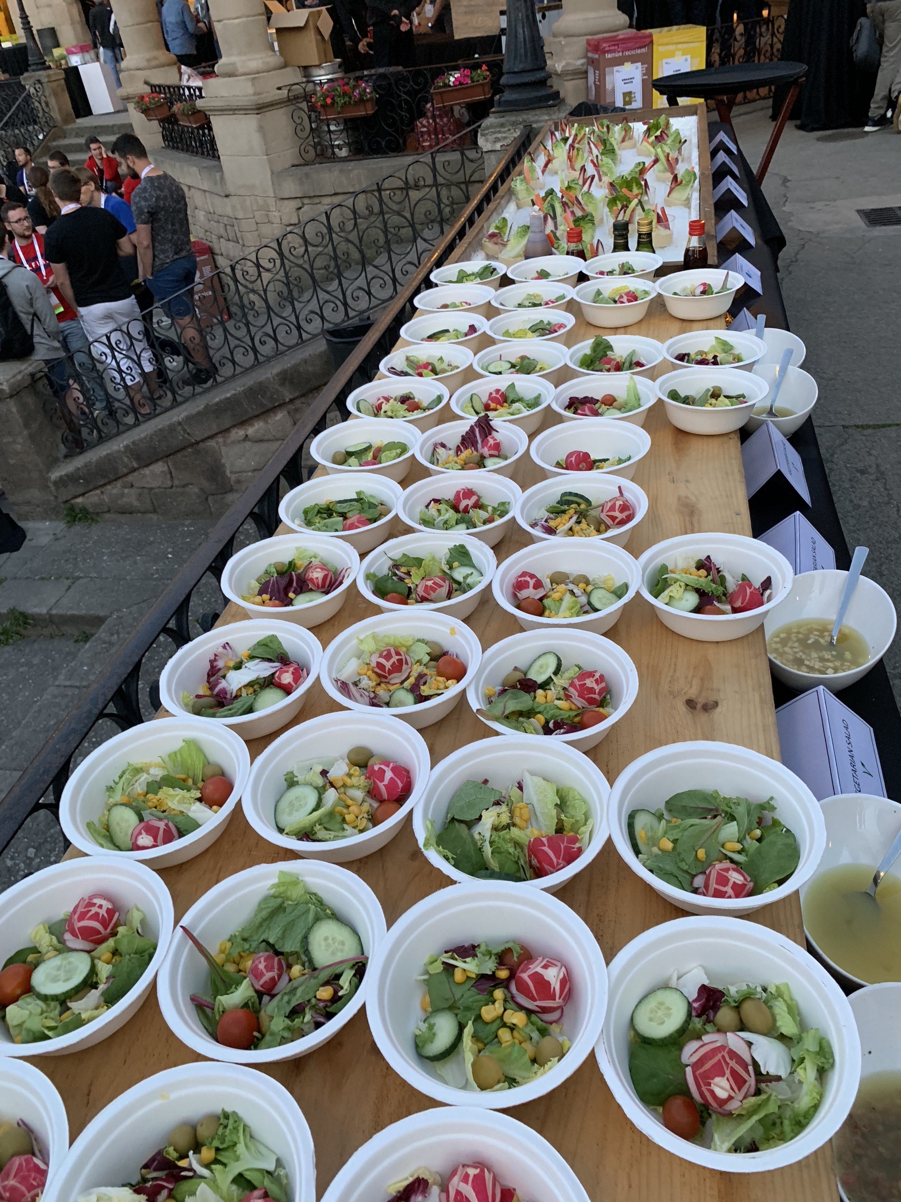
Some photos of KubeCon EU

Slide 12
Upcoming community events – KubeCon Shanghai
KubeCon CHN @ Shanghai June 24th –June 26th
CNCF China Originated Projects Community Reception 14:00-17:00 June 24th
Harbor, Dragonfly, TiKV
Lightning Talk: New Helm Chart Installation Experience with Visual and Repeatable Approach by Steven Zou at 16:16-16:21 June 24th
All about Harbor by Steven Zou & Wenkai yin at 14:55 June 25th
Upgrade Images by Digging Out and Automatically Fixing the Vulnerabilities - Yan Wang & Steven Zou at 16:00 June 26th
Some of the content from one of the community project initialized by Ru Lin. Big thanks to Ru Lin!

Slide 13
Topics?
Any topics to discuss here?

Slide 14
Meeting minutes
Meeting is recorded and the recording link will be updated to the meeting schedule doc later: https://github.com/goharbor/community/blob/master/MEETING_SCHEDULE.md
The meeting slides will be uploaded to the community repo https://github.com/goharbor/community and put under the ‘conf-calls’ folder.

